Slide 1
Course Name: Web Information Retrieval
PageRank
Qingcai Chen
ICRC HIT (Shenzhen)
Sept.30, 2019

Slide 2
Content
Background
Basic Idea
PageRank Algorithm
HITS: Hyperlink-Induced Topic Search
Further Reading
HITS: Hyperlink-Induced Topic Search,
referred from: Pandu Nayak and Prabhakar Raghavan, Lecture 17: Link Analysis

Slide 3
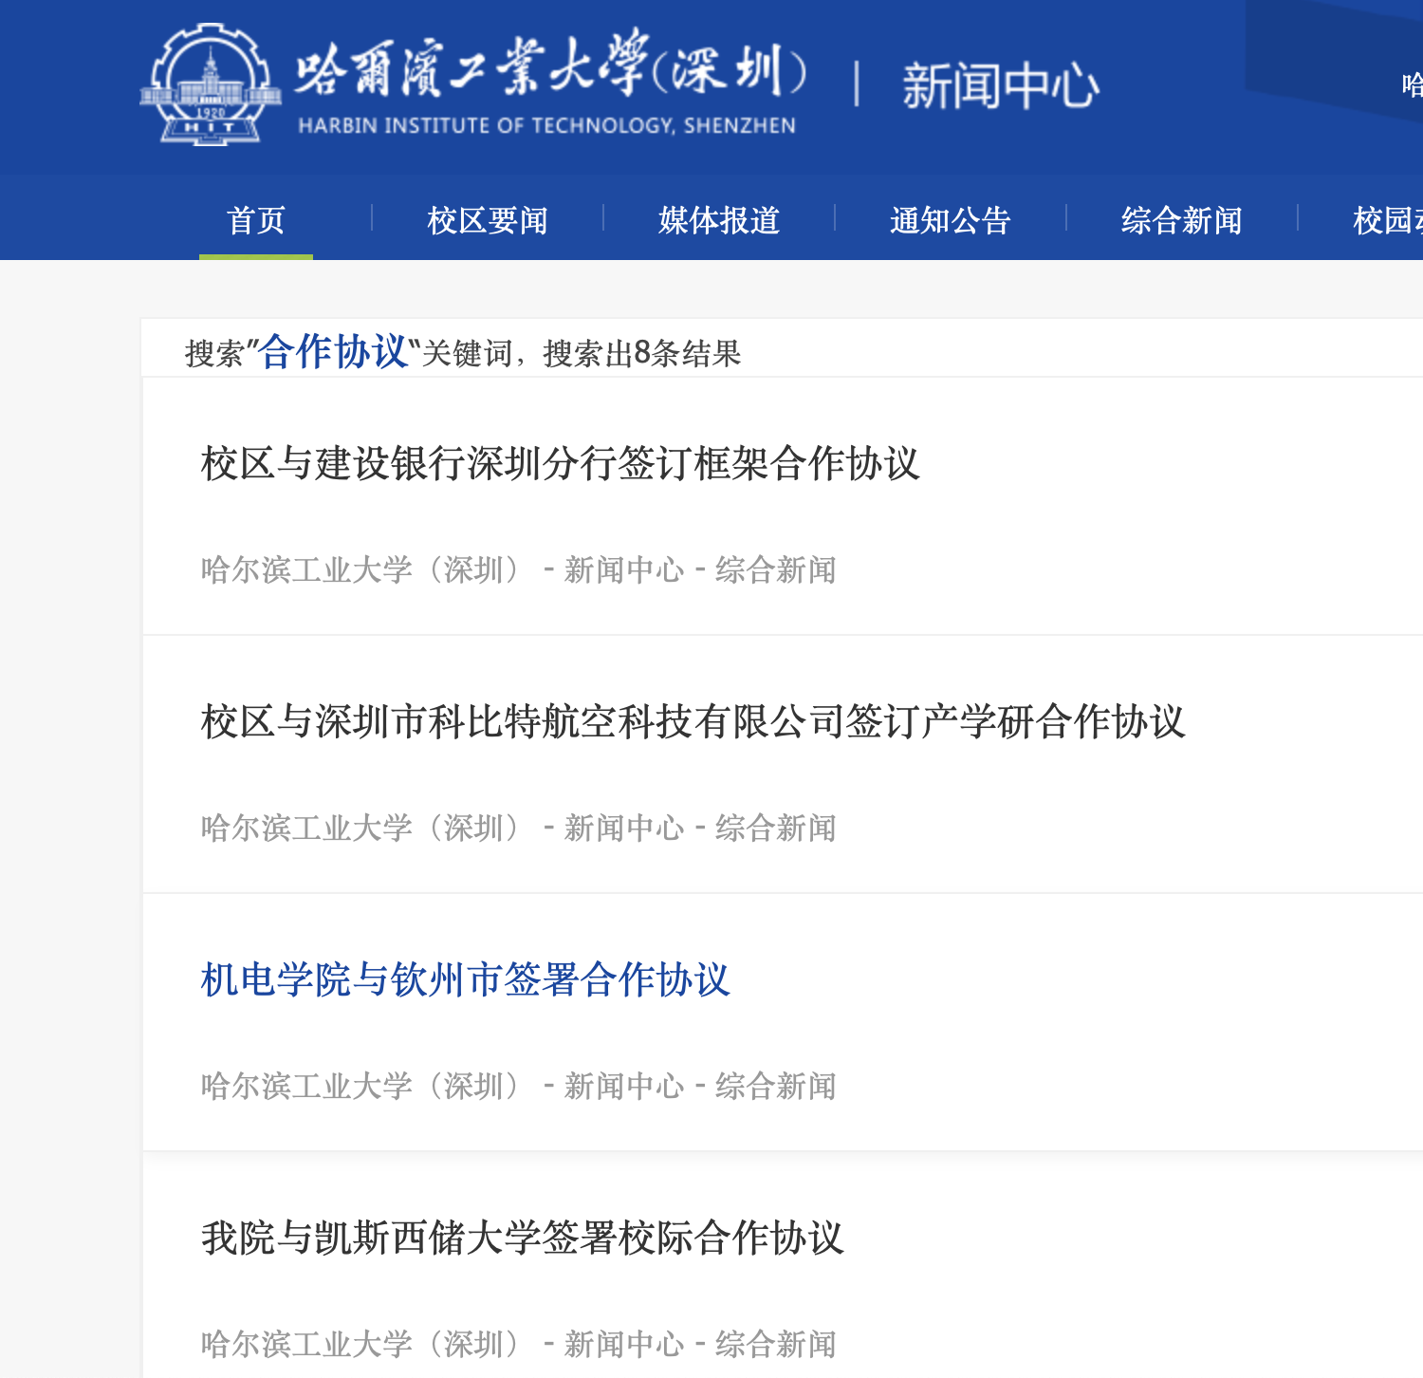
Background
Example 1. submit a query in the search box
What’s the user’s expectation?
documents about “校际合作协议”？
or about “市校合作协议”？
“校企合作协议”？
all of them?
How the system makes decisions about relevance of query and documents?
Both questions are not so critical since there are just 5 documents contain the query word.

Slide 4

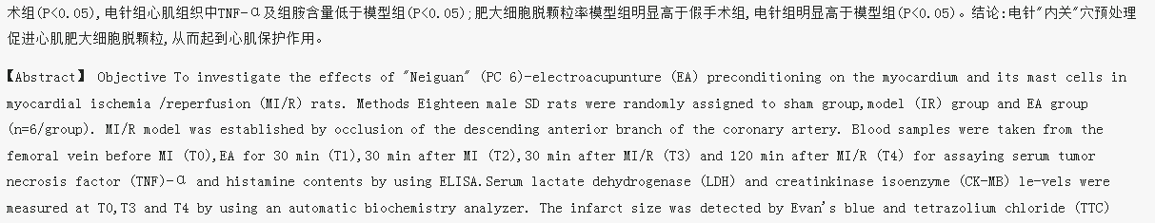
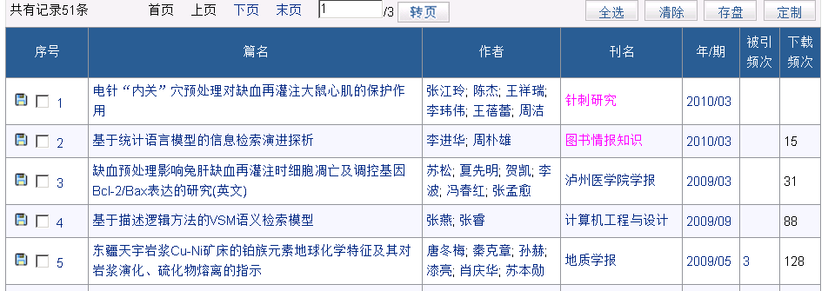
Background
Example 2. a more complicate query, search in a moderate (million) scale document set
?...
our expectation

Slide 5
Background
Example 2. a more complicate query, search in a moderate (million) scale document set
Information retrieval models are required to find out relevant documents
Vector space model
Statistical language model
Probabilistic model
……
Goal of IR models: increase search precision by
Understanding user’s information needs
Providing techniques for computing relevance (or similarity) of query and documents

Slide 6
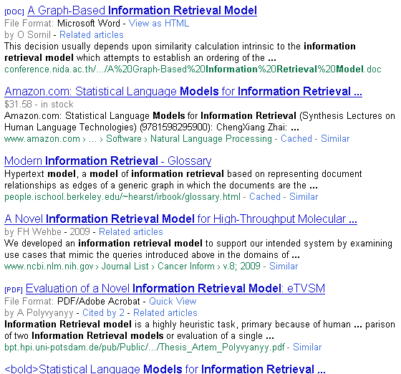
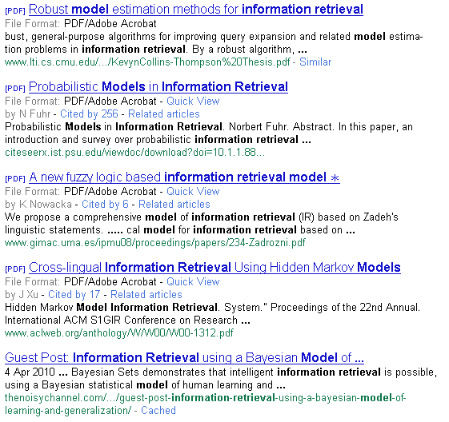
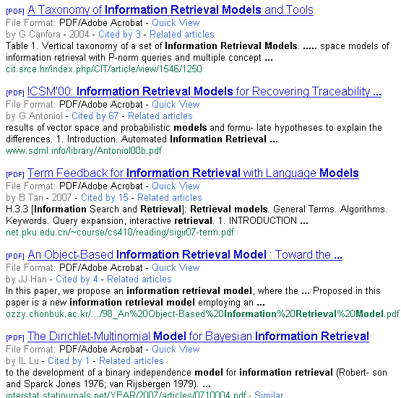
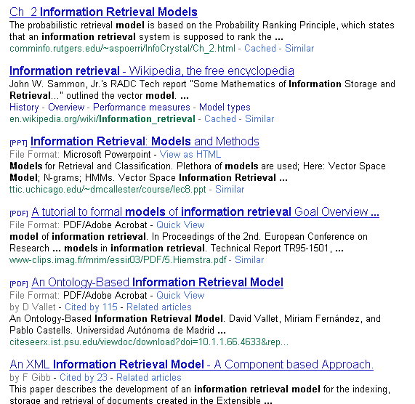

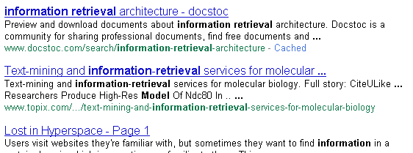

Background
Example 3. do the same search (with more specific keywords of Example 2) via Google

Slide 7
Background
Example 3. do the same search (with more specific keywords of Example 2) via Google
Now the critical problem becomes:
Which kind of documents should be presented on the 1st page?
It’s not a question about relevant, rather than, it’s a question about
Which document is more important?

Slide 8
Background
Document measures
Relevance, as conventionally defined, is binary (relevant or not relevant). It is usually estimated by the similarity between the terms in the query and each document: Boolean Model, Vector Space Model, Statistical Language Model, etc.
Importance measures documents by their likelihood of being useful to a variety of users. It is usually estimated by some measure of popularity.
Web search engines rank documents by a combination of relevance and importance. The goal is to present the user with the most important of the relevant documents.
Then, how to compute the importance of a web document?

Slide 9
Basic Idea
The question about “importance” also comes from the domain “Bibliometrics (文献计量学)”

Slide 10
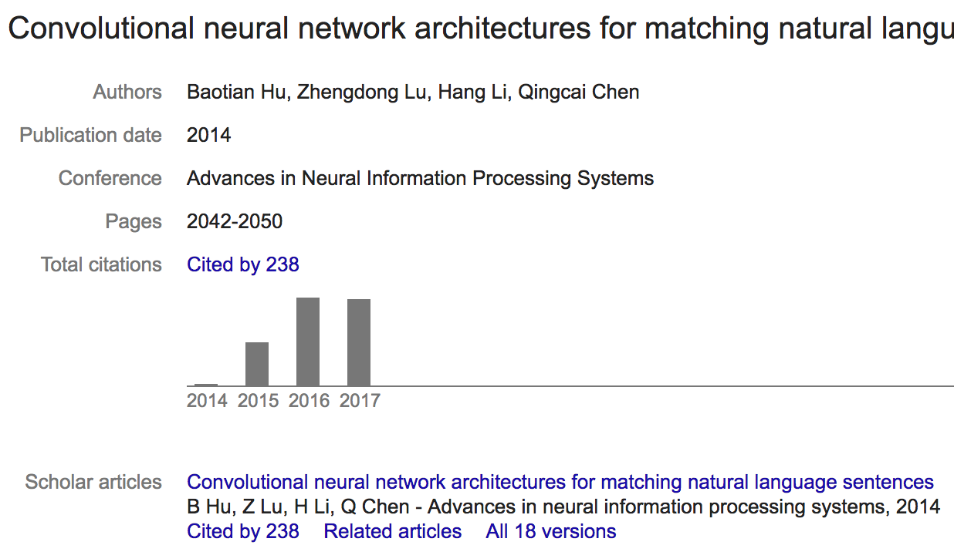
Basic Idea
Bibliometrics (文献计量学):
Techniques that use citation analysis to measure the similarity of journal articles or their importance
Bibliographic coupling (引文耦合):
two papers that cite many of the same papers
Co-citation (协同引用):
two papers that were cited by many of the same papers
Impact factor (of a journal)(影响因子):
frequency with which the average article in a journal has been cited in a particular year or period
measure of “importance” of a journal

Slide 11
Basic Idea
Basic philosophy implied in Impact Factor:
The importance of a journal or a paper is enhanced if more papers cite it.
Just those citations that come from important journals are counted.

Slide 12
Citation Graph - Visualization of Citations
Note that journal citations always refer to earlier work.
Directed Acyclic Graph(有向无环图, DAG)
cites
Paper
cited by

Slide 13
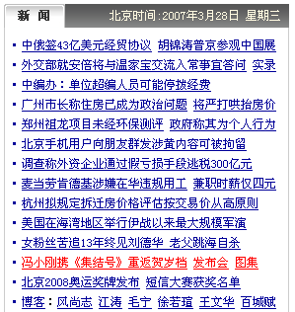
Graphical Analysis of Hyperlinks on the Web
What’s the difference between Hyperlink graph and Citation graph?
This page links to many other pages (hub)
2
1
4
Many pages link to this page (authority)
3
5
6
Matrix Representation

Slide 14
PageRank Algorithm
Used to estimate importance of documents.
Inspired by the Impact Factor.
Basic Concept:
1. The rank of a web page is higher if many pages link to it.
2. Links from highly ranked pages are given greater weight than links from less highly ranked pages.
Question:
How do we know the rank of a web page that is linking to the web page under consideration?

Slide 15
Intuitive Model (no damping)
A user:
1. Starts at a random page on the web
2. Selects a random hyperlink from the current page and jumps to the corresponding page
Repeats Step 2 a very large number of times
Pages are ranked according to the relative frequency with which they are visited.
After T times (and T is
large enough), we get
P₁ ： 0
12
？
P₂： 0
1
11
…
P_{i}： 0
1
50
P_{i+1}：0
50
…
P_{N}： 0
8
Then we can compute the rank (importance) of each webpage according to its visiting times
Notes:
Then what’s the connection of this model with the impact factor computing method and our basic concept?

Slide 16
Intuitive Model (Probabilistic Model)
It’s a stochastic process
To get a precise estimation of visiting times is not practicable
Estimate the visiting probability of one webpage by the visiting probability of webpages Link In to it, for the example, we get:
We just want to get a relative importance (PageRank value), use w to replace the probability symbol” Pr”, and get the matrix form:
,
or
for
is the Link Out of webpage P_{j}
Notes:
From Pr(P1), Pr(P2)…, to Pr(PN), then we get the matrix form.

Slide 17
Matrix Representation
The Citation Graph
Citing page (from)
P₁ P₂ P₃ P₄ P₅ P₆ Number
P₁ 1 1
P₂ 1 1 2
P₃ 1 1 1 3
P₄ 1 1 1 1 4
P₅ 1 1
P₆ 1 1
P₂ cites P₃
Cited page (to)
Number 4 2 1 1 3 1

Slide 18
Basic Algorithm: Normalize by Number of Links from Page
Citing page
P₁ P₂ P₃ P₄ P₅ P₆
P₁ 0.33
P₂ 0.25 1
P₃ 0.25 0.5 1
P₄ 0.25 0.5 0.33 1
P₅ 0.25
P₆ 0.33
= B
Cited page
Normalized link matrix
Number 4 2 1 1 3 1

Slide 19
Basic Algorithm: Weighting of Pages
Initially all pages have weight 1
w₀ =
Recalculate weights
w₁ = Bw₀ =
Here the first iterating weight for P1 is
w₁₁ = B₁●w₀
= b₁₁*w₀₁ + … + b₁₅*w₀₅ + …
= 0 * 1 + … + 0.33 * 1 + …
=0.33
0.33
1.25
1.75
2.08
0.25
0.33
1
1
1
1
1
1

Slide 20
Basic Algorithm: Iterate
Iterate: w_{k} = Bw_{k-1}
w₀ w₁ w₂ w₃ ... converges to ... w
1
1
1
1
1
1
0.33
1.25
1.75
2.08
0.25
0.33
0.08
1.83
2.79
1.12
0.08
0.08
0.03
2.80
2.06
1.05
0.02
0.03
->
->
->
->
->
->
0.00
2.39
2.39
1.19
0.00
0.00

Slide 21
Graphical Analysis of Hyperlinks on the Web
There is no link out of {2, 3, 4}
2
1
4
3
5
6

Slide 22
Discussion: How to deal with the issue of link loops?

Slide 23
Google PageRank with Damping
A user:
1. Starts at a random page on the web
2a. With probability d, selects any random page and jumps to it
2b. With probability 1-d, selects a random hyperlink from the current page and jumps to the corresponding page
3. Repeats Step 2a and 2b a very large number of times
Pages are ranked according to the relative frequency with
which they are visited.
Now, can we construct this new model?

Slide 24
The PageRank Iteration
The basic method iterates using the normalized link matrix, B.
w_{k} = Bw_{k-1}
This w is the high order eigenvector of B (i.e., w = Bw)
PageRank iterates using a damping factor. The method iterates:
w_{k} = dw₀ + (1 - d)Bw_{k-1}
w₀ is a vector with every element equal to 1.
d is a constant found by experiment.

Slide 25
Iterate with Damping
Iterate: w_{k} = dw₀ + (1-d)Bw_{k-1} (d = 0.3)
w₀ w₁ w₂ w₃ ... converges to ... w
1
1
1
1
1
1
0.53
1.18
1.53
1.76
0.48
0.53
0.41
1.46
2.03
1.29
0.39
0.41
0.39
1.80
1.78
1.26
0.37
0.39
->
->
->
->
->
->
0.38
1.68
1.87
1.31
0.37
0.38

Slide 26
Google: PageRank
The Google PageRank algorithm is usually written with the following notation
If page A has pages T_{i} pointing to it.
d: damping factor
C(T_{i}): number of links out of T_{i}
n: number of pages pointing to A
Iterate until:
Notes:
It is equivalent

Slide 27
Information Retrieval Using PageRank
Simple Method
Consider all hits (i.e., all document vectors that share at least one term with the query vector) as equal.
Display the hits ranked by PageRank.
The disadvantage of this method is that it gives no attention to how closely a document matches a query
（i.e. No Relevance)

Slide 28
Combining Term Weighting with Reference Pattern Ranking
Combined Method
1. Find all documents that share a term with the query vector.
2. The similarity, using conventional term weighting, between the query and document j is s_{j}.
3. The rank of document j using PageRank or other reference pattern ranking is p_{j}.
4. Calculate a combined rank c_{j} = λs_{j} + (1- λ)p_{j}, where λ is a constant.
5. Display the hits ranked by c_{j}.
This method is used in several commercial systems but the details have not been published.

Slide 29
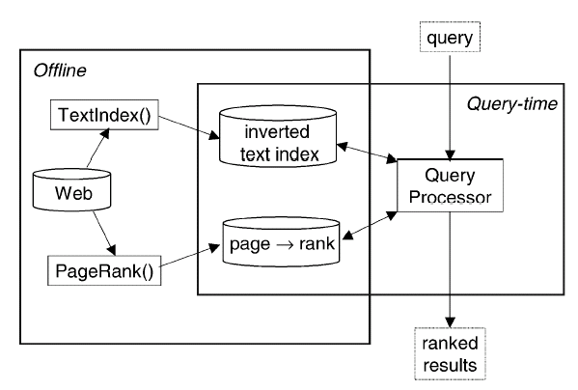
A standard search engine scheme by using PR
Haveliwala: Topic-sensitive Pagerank: A Context-sensitive Ranking Algorithm for Web Search

Slide 30
Topic sensitive PageRank

Slide 31
Topic sensitive PageRank
Basic Idea:
Once users random select one page to jump to, they may jump just among the webpages that belong to the same subject (or topic).

Slide 32
Topic Sensitive PageRank
Haveliwala: Topic-sensitive Pagerank: A Context-sensitive Ranking Algorithm for Web Search, 2003
Assigns multiple a-priori “importance” estimates to pages
One PageRank score per basis topic
Query specific rank score
Make use of context
Inexpensive at runtime
Basis topics come from Yahoo, ODP (Open Directory Project http://www.dmoz.org/ ) etc.
Notes:
a priori: (1)adj: relating to or denoting reasoning or knowledge which proceeds from theoretical deduction rather than from observation or experience. (2) adv: in a way based on theoretical deduction rather than empirical observation

Slide 33
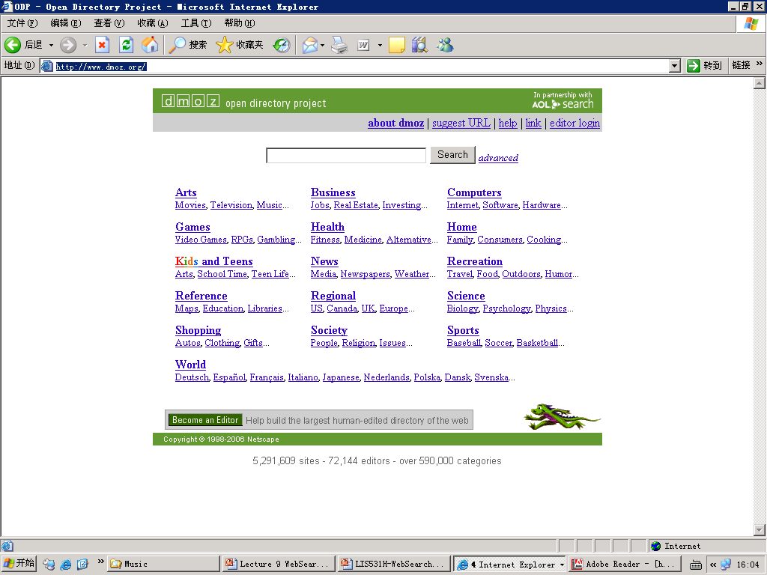
Open Directory Project

Slide 34


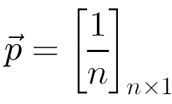

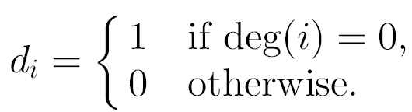

Matrix form of PageRank
The main difference from our previous damping equation
w_{k} = dw₀ + (1 - d)Bw_{k-1}
Basic PageRank (in matrix form)
Here, if there is a link from page j to page i, then the matrix entry m_{ij} have the value 1/C(P_{j}) ,otherwise be 0.
p be the n-dimensional column vector representing a uniform probability distribution over all nodes:
be the n-dimensional column vector identifying the nodes with link-out 0:
and
Why we need the matrix D?
Notes:
Here M denotes the same matrix as B in previous foils.
For D, means that if a webpage get no out link, then we jump out of the webpage and all the webpage get the same chances of being visited as the initial time.

Slide 35


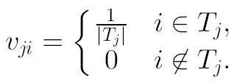

ODP-Biasing of PageRank
Let T_{j} be the set of URLs in the ODP category c_{j}.
computing the PageRank vector for topic c_{j}, in place of the uniform damping vector
i.e. let and
The PageRank vector for topic c_{j} is given by
that can be computed by the basic PR algorithm
Notes:
The bias here is for the URLs contained in ODP, i.e., if the webpage is not contained in ODP, then it gets the initial probability of 0 for all categories.

Slide 36
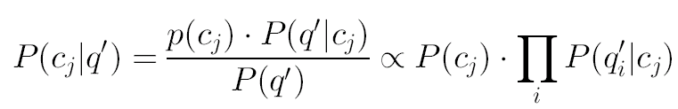

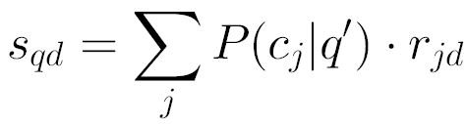
Query-Time Importance Score
Categorizing the query q
Let q_{i}’ be the i^{th} term in the query (or query context) q’. Then given the query q’, compute for each c_{j} the following:
Let r_{jd} be the rank of document d given by the rank vector , then for the Web document d, the query-sensitive importance score s_{qd} is computed as follows
Keep the same for all c_{j}
Notes:
Bayes Equation和名实转换的关系：上面的公式中，最左侧的P(cj|q’)中的cj可以看成是这个类别的一个名，是个抽象的概念，比如“计算机”，是一个类别的名称，那判别一个实际的q’是否能够贴上这个类别名，或者说能够贴上“计算机”这个标签的概率，需要从认知的角度来得到答案。但是当用Bayes公式进行转换后，这个P(q’|cj)中的cj则是“实”，是指的在ODP中这个类别的文档的集合。这时候，就可以用最大似然估计来进行统计计算概率了。

Slide 37
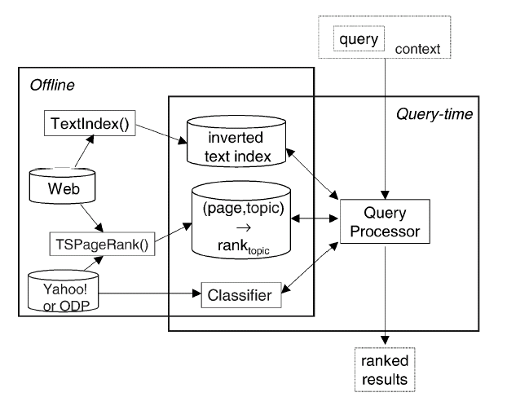
SE System scheme with TS PageRank

Slide 38
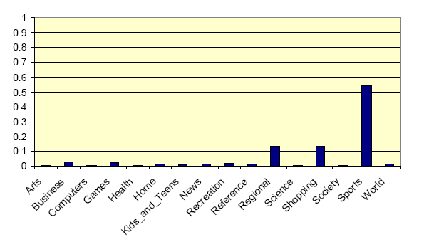
Example Topic Distribution
For the query ‘golf’, with no additional context the distribution of topic weights we would use is:

Slide 39
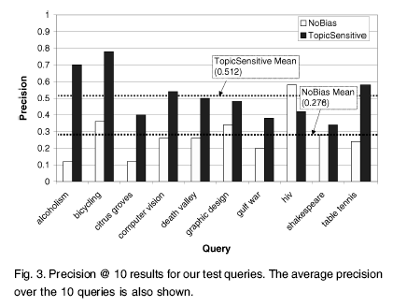
Experiment Results TSPageRank vs. PageRank
From: Haveliwala, Topic-sensitive Pagerank: A Context-sensitive Ranking Algorithm for Web Search, 2003

Slide 40
Adaptive Search –Searching Context
Rather than use query q itself, use the context of q to compute the topic distribution and PageRank values.
The query context can be:
The query history for the same user
The user provided text that contains the query terms

Slide 41
Paper Discussion(Homework)
Then, why is this paper named “topic-sensitive”?
What’s the problem this paper was trying to address?
What’s the role of matrix D?
Why we need the ODP or other similar project for the computing of multiple page ranks for a given page?

Slide 42
Content
Background
Basic Idea
PageRank Algorithm
HITS: Hyperlink-Induced Topic Search
Further Reading
HITS: Hyperlink-Induced Topic Search,
referred from: Pandu Nayak and Prabhakar Raghavan, Lecture 17: Link Analysis

Slide 43
Hyperlink-Induced Topic Search (HITS)
Sec. 21.3
In response to a query, instead of an ordered list of pages each meeting the query, find two sets of inter-related pages:
Hub pages are good lists of links on a subject.
e.g., “Bob’s list of cancer-related links.”
Authority pages occur recurrently on good hubs for the subject.
Best suited for “broad topic” queries rather than for page-finding queries.
Gets at a broader slice of common opinion.

Slide 44
Hubs and Authorities
Sec. 21.3
Basic Assumption
A good hub page for a topic points to many authoritative pages for that topic.
A good authority page for a topic is pointed to by many good hubs for that topic.
Circular definition - will turn this into an iterative computation

Slide 45
The hope
Sec. 21.3
Authorities
Hubs
Mobile telecom companies

Slide 46
High-level scheme
Sec. 21.3
Extract from the web a base set of pages that could be good hubs or authorities.
From these, identify a small set of top hub and authority pages
iterative algorithm

Slide 47
Base set
Sec. 21.3
Given text query (say browser), use a text index to get all pages containing browser.
Call this the root set of pages.
Add in any page that either
points to a page in the root set, or
is pointed to by a page in the root set.
Call this the base set.

Slide 48
Construct the Base Set
Sec. 21.3
Root
set
Base set
Get in-links (and out-links) from a connectivity server

Slide 49
Distilling hubs and authorities
Sec. 21.3
Compute, for each page x in the base set, a hub score h(x) and an authority score a(x).
Initialize: for all x, h(x)←1; a(x) ←1
Iteratively update all h(x), a(x)
After iterations
output pages with highest h() scores as top hubs
highest a() scores as top authorities.
Key

Slide 50
Iterative update
Sec. 21.3
Repeat the following updates, for all x:
x
x

Slide 51
Scaling
Sec. 21.3
To prevent the h() and a() values from getting too big, can scale down after each iteration
Scaling factor doesn’t really matter:
we only care about the relative values of the scores.

Slide 52
How many iterations?
Sec. 21.3
Claim: relative values of scores will converge after a few iterations:
in fact, suitably scaled, h() and a() scores settle into a steady state!
In practice, ~5 iterations get you close to stability.

Slide 53
Things to note
Sec. 21.3
Pulled together good pages regardless of language of page content.
Use only link analysis after base set assembled
iterative scoring is query-independent.
Iterative computation after text index retrieval - significant overhead.

Slide 54
Content
Background
Basic Idea
PageRank Algorithm
HITS: Hyperlink-Induced Topic Search
Further Reading
HITS: Hyperlink-Induced Topic Search,
referred from: Pandu Nayak and Prabhakar Raghavan, Lecture 17: Link Analysis

Slide 55
Further Reading
First publication that detail introduces Google’s techniques by it’s founders:
Brin, S. and Page, L., The Anatomy of a Large-Scale Hypertextual Web Search Engine. WWW 1998, April 14-18, 1998, Brisbane, Australia
Lawrence Page, Sergey Brin, Rajeev Motwani, Terry Winograd, 'The PageRank Citation Ranking: Bringing Order to the Web', 1998
Taher H. Haveliwala, ‘Efficient Computation of PageRank’, Stanford Technical Report, 1999
One of the important variations for PageRank:
Haveliwala T.H. Topic-sensitive Pagerank: A Context-sensitive Ranking Algorithm for Web Search, IEEE Trans. on Knowledge and Data Engineering, vol.15(4), 2003: 784-796
HITS:
Kleinberg, Jon (1999). "Authoritative sources in a hyperlinked environment" . Journal of the ACM 46 (5): 604–632.

